Slide 1
To approve all school subjects
Team Members
Santiago pineda Higuita
Cristian Camilo Jiménez Trejos
María Camila Carvajal Osorno
María Betancur

Slide 2
Contenido
1.Dedication
2.Puntuality
3.Put forward to the study
4.Discipline
5.Be very responsible
6.Provision in the explanation
7.Respect
8.Meet the explanations
9.Not have bad friends
10.Not distracted

Slide 3
Dedication

Slide 4
Puntuality

Slide 5
Put forward to the study

Slide 6
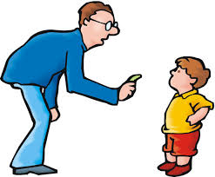
Discipline

Slide 7
Be very responsible

Slide 8
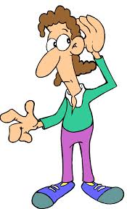
Provision in the explanation

Slide 9
Respect

Slide 10
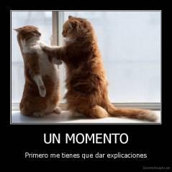
Meet the explanations

Slide 11
Not have bad friends

Slide 12
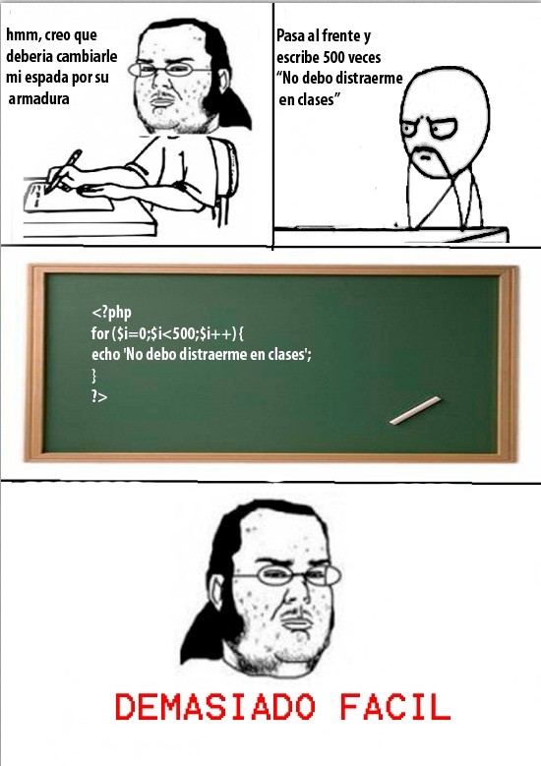
Not distracted

