Slide 1
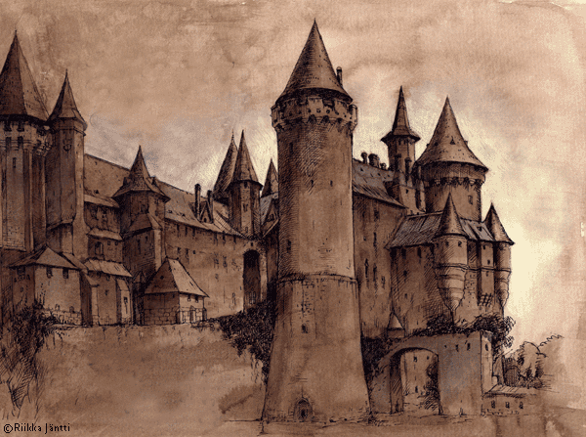
Adventures in the Castle
Adventures in the
Castle

Slide 2
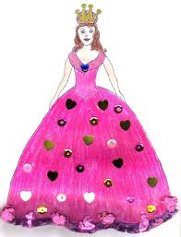
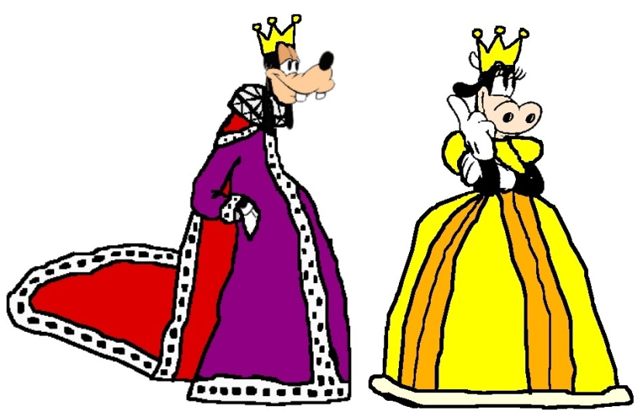
Once upon a time there was a young princess who lived in a big castle with her parents. They were very very happy and they loved to spend time together. Marissa, the young lady , was very popular in town because of her beauty and she had many pretenders, but her parents were very strict and they didn’t want her to get a boyfriend.

Slide 3
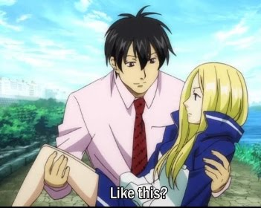
But lately she met a handsome gardener from the castle and really felt in love each other. As her parents could not realize this, they used to go for a walk every afternoon and enjoyed themselves. One day, she told her boyfriend she was pregnant and they decided to run away.

Slide 4
When her parents were told about the escape, they got sad and started to look for them all over the country...

Slide 5
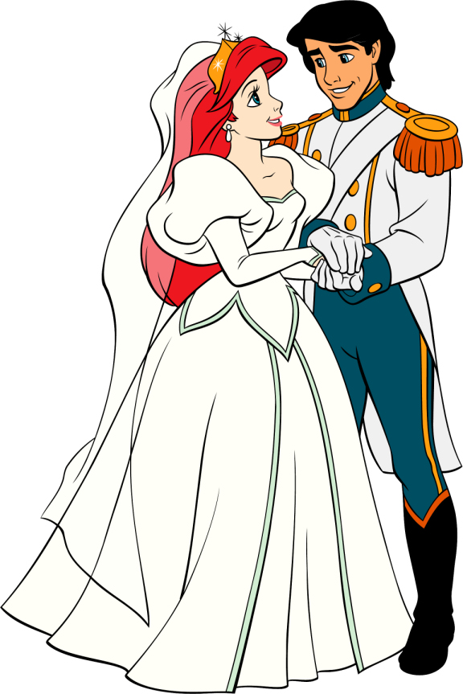
At last, they found them and said to Marissa:
«We love you so much and accept your new family! Come with us and let’s make a big weeding party!»
Marissa and Mr. Plant were very happy and live together for a long long time

